Slide 1
Tohono O’odham Nation Health Care
Infection Control Program

Slide 2
Role of the Infection Preventionist, aka, the Infection Control Nurse
1. Investigate, intervene, prevent and control infection any time there is a breach in infection control practices.
2. Report any suspected or confirmed case
3. Educate staff on infection prevention
4. Enforce infection control policies and procedures.

Slide 5
The primary goal of an infection control program is to…..
Prevent Healthcare Associated Infections (HAI)
Surgical Site Infections (SSI)
Catheter Associated Urinary Tract Infection (CA-UTI)
Central Line Infection (CLABSI)
Hospital Acquired Pneumonia (HA-PNA)
Multiple Drug Resistant Organisms (MDRO)

Slide 6
Healthcare Associated Infections
HAI account for more than 2 million infections a year
HAI cost $20 billion, yes, billion a year
HAI cost $35 million a year in societal costs
HAI cost 8 million additional hospital days a year
Every day more than 250 people die from a HAI
  Do the math: 250 deaths x 365 days = 91,250 deaths per year
  More that 250 people die, so let’s just call it 100,000 deaths per year
  By comparison, motor vehicle deaths cause around 50,000 deaths per year

Slide 7
Regulatory Agencies
Centers for Medicare and Medicaid Services (CMS)
In 2014, CMS required mandatory focus on adverse outcomes including Healthcare Associated Infections (HAI)
  Ties the “Conditions of Participation” to reimbursement and licensure
  Mandates evidence-based practices
  Requires a decrease of HAI by 40%
The Joint Commission (TJC)
The Joint Commission surveys healthcare facilities nationwide for standards of care
  TJC uses evidence based-practices to provide the best outcome for patients
  TJC provides accreditation to a healthcare facility

Slide 8
CMS-Focus on Adverse Outcomes: HAI and Multi-Drug Resistant Organisms (MDRO)
CMS identified a rise in health care costs related to Healthcare Associated Infections (HAI)
CMS called for an evaluation of this trend by the Healthcare Infection Control Practices Advisory Committee (HICPAC).
HICPAC is a nation regulatory committee that provides advice and guidance to the CDC and Secretary of the Department of Health and Human Services regarding healthcare practice and infection control strategies for surveillance and prevention of HAI in the United States.
  HICPAC found that the 1996 Universal Policy did not address current practices RE novel viruses, MDROs, MDR-TB and MDR-HIV/TB.
  HICPAC found the return of vaccine preventable disease and lack of antibiotic stewardship

Slide 9
Other Findings Impacting HAI
Private insurance mandating shorter hospital stays
Patients transferred to Long-Term Care (LTC), rehabilitation centers or to outpatient status
Long-Term Care and rehabilitation facilities we not held to the standards found in hospitals
Lack of antibiotic stewardship
Patients with worsening conditions needing readmission to a hospital with a HAI.
Novel infectious diseases: SARS, Avian Flu, H1N1, bioterrorism
Lack of appropriate respiratory etiquette
Lack of a proper sequence to put on and take off personal protective equipment (PPE)
Lack of strategies to prevent HAI
Lack of environmental controls-cleaning and disinfection of equipment and treatment areas

Slide 10
The Joint Commission: National Patient Safety Goals to Prevent Infection
NPSG.07.01.01 Use the hand cleaning guidelines from the Centers for Disease Control and Prevention or the World Health Organization. Set goals or improving hand cleaning. Use the goals to improve hand cleaning
NPSG.07.03.01 Use proven guidelines to prevent infections that are difficult to treat
NPSG.07.04.01 Use proven guidelines to prevent infection of the blood from central lines
NPSG.07.05.01 Use proven guidelines to prevent infection after surgery
NPSG.07.06.01 Use proven guidelines to prevent infections of the urinary tract that are caused by catheters

Slide 11
Healthcare Associated Infection Surveillance
Catheter Associated-Urinary Tract Infection (CAUTI)
Most common HAI-40%
Checklist
Why placed?
When placed?
Where placed?
Who placed?
When can it be removed?
Central Line Blood Stream Infections (CLABSI)
Less than 15% of HAI but highest mortality: 15-25%
Checklist
  Why placed?
  Where placed?
  When placed?
  When can it be removed?
  Central lines are not placed here but we do care for patients who have them

Slide 12
Healthcare Associated Infection Surveillance
Multiple-Drug Resistant Organisms (MDRO)
  Methicillin Resistant Staphylococcus aureus-MRSA
  Clindamycin resistant MRSA
  Wound culture surveillance
  Antimicrobial stewardship
  Checklist
    Culture surveillance
    History MDRO
    Appropriate antibiotic use-colonized vs infection
Surgical Site Infection (SSI)
15-30% of HAI
Checklist
  Where?
  When?
  Risk factors-DM
  Proper orders/products
  Proper documentation
  Surgical procedures not done at TONHC;
  many patients receive wound care here

Slide 13
Healthcare Associated Infection Surveillance
Ventilator-Associated Pneumonia (VAP)
Patients on ventilators not seen at TONHC
  Primary concern for patients here is monitoring patients with a recent history of a hospital admission requiring a ventilator
  Good pulmonary hygiene in patients admitted to inpatient-early mobilization

Slide 14
Annual Infection Control Patient Population Assessment-CMS/TJC requirement
More than ¾ of our patient population have Diabetes; many have concurrent co-morbidities
  Obesity
  Diabetic neuropathies-diabetic foot ulcers; amputations
  Circulatory complications-stasis ulcers, peripheral vascular disease
  As many as 40% of our patient population have Community Acquired MRSA (CA-MRSA)
  An increasing number of MRSA infections are Clindamycin resistant

Slide 15
Some not so great statistics on DM patients with foot ulcers
80% have diabetic neuropathy
75% have peripheral vascular disease
25% of patients with a DM foot ulcer will have an infection that will spread to subcutaneous tissue and/or bone
50% will develop another foot wound within 1-2 years
10-30% of patients with a DM foot ulcer will need an amputation-a toe, a foot, a leg
60% of those amputations will be preceded by an infected DM foot ulcer

Slide 16
Diabetic Foot Care at TONHC
Patients can see a podiatrist at all four clinic sites
Currently two full-time podiatrists on staff with positions posted
Podiatrists can treat DM foot ulcers
Annual foot exam for all DM patients
Scheduled “shoe clinics” for fitted orthotics
Routine wound care of DM foot ulcers
Two full-time podiatry nurses
  Perform annual DM foot exams
  Wound care

Slide 17
What does all this mean for TONHC?
Most importantly, improved patient outcomes-no HAI
The best evidence-based practices to provide safe care to our patients
Inpatient
Outpatient
Emergency Room
Staff education
Reimbursement
Accreditation

Slide 18
Standard Precautions and Transmission Based Isolation Guidelines Policy: 2017
1. PPE and sequence of “donning and doffing”
2. Hand hygiene
3. Alcohol-based hand rubs (ABHR)
4. Disinfectants and procedural protocol
5. Education: Staff, patients, caregivers and visitors
6. Artificial nails and piercings
7. Ten safe injection practices

Slide 19
Getting Down to the Basics of Infection Control
Hand Hygiene, Respiratory Etiquette, Precautions and PPE, Low Level Disinfection, and Sharp/Medical Waste Disposal

Slide 20
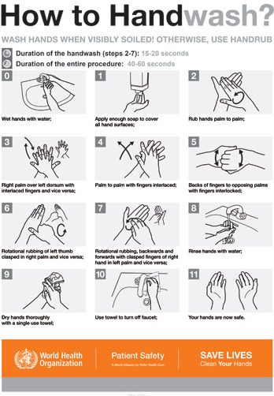
Hand Hygiene
Contaminated hands are the NUMBER ONE cause of HAI
If soiled with blood or OPIM, wash hands with soap and water for 20 seconds. Timing begins when hands are wet and soapy.
Remember the back of your hands, between your fingers, your palms, cuticles, underneath your nails

Slide 21
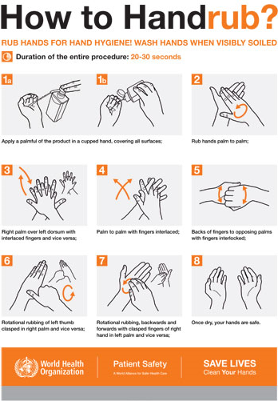
Hand Hygiene
Contaminated hands are the NUMBER ONE cause of HAI….I cannot say this enough!
If hands are clean, use an alcohol base hand rub (ABHR) over hand washing

Slide 22
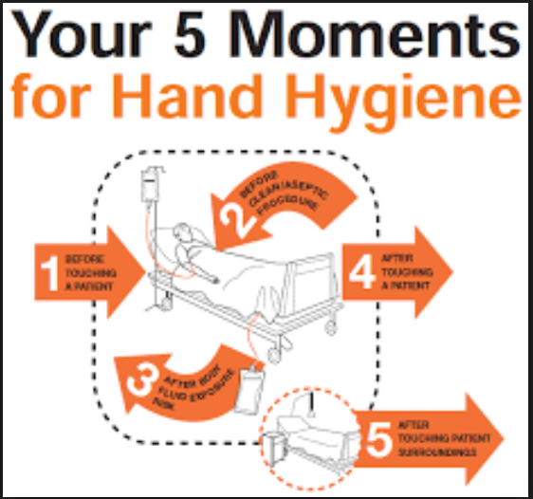
Hand Hygiene
When you enter a treatment area
Before you touch a patient
Before a procedure
Between procedures
After a procedure
After touching a patient
After touching equipment
When you leave the room

Slide 23
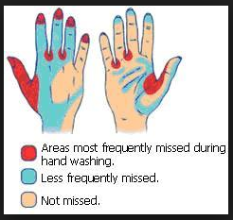
Hand Hygiene
Rings and things-watches, bracelets
Artificial nails
Sleeves and clothing
Using the bathroom
Eating-before and after
That cough, that sneeze, that itchy nose
What is outside that patient room
Telephones
Computer keyboards
And a hundred other surfaces….

Slide 24
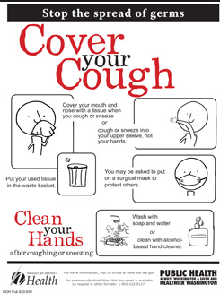
Respiratory Etiquette
The three foot rule aka “spitting distance”
PPE stations at entrances to clinic and in patient care area-masks, alcohol rub, Kleenix
Ask patients/family to “cover that cough”
Never pass up a teaching moment with a patient, a family member

Slide 25
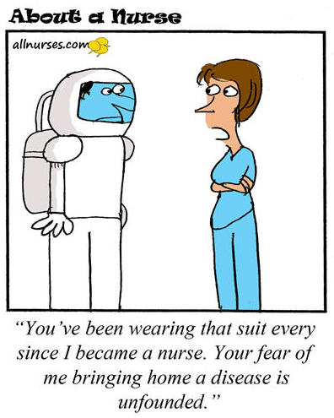
Precautions
Standard Precautions aka Universal Precautions
Contact Precautions
Droplet Precautions
Airborne Precautions
Enteric Precautions

Slide 26
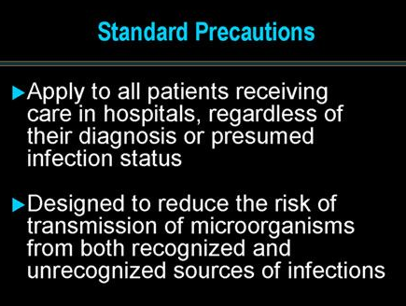

Standard Precautions

Slide 27
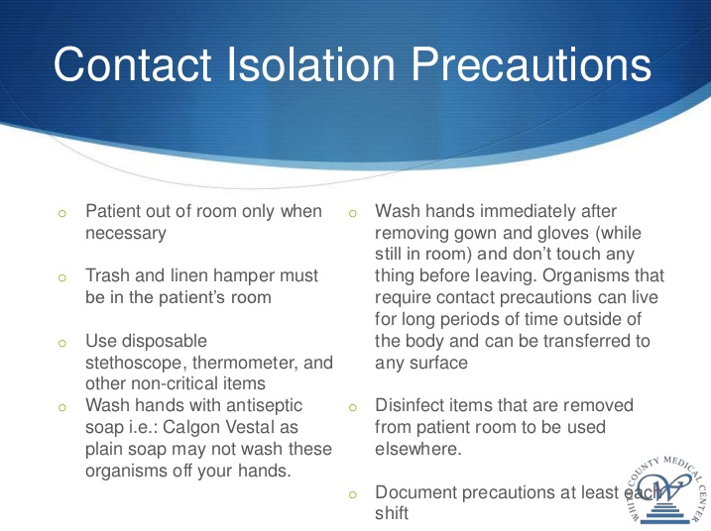
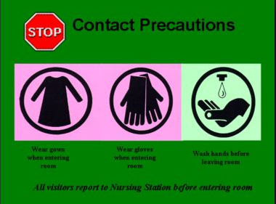
Contact Precautions

Slide 28
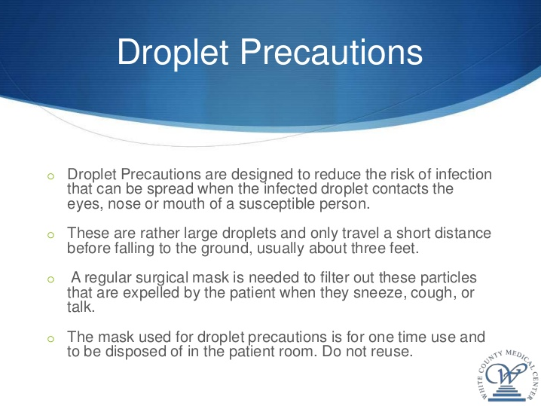
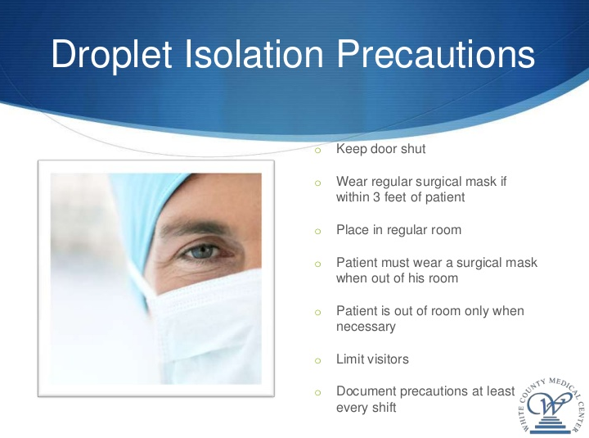
Droplet Precautions

Slide 29
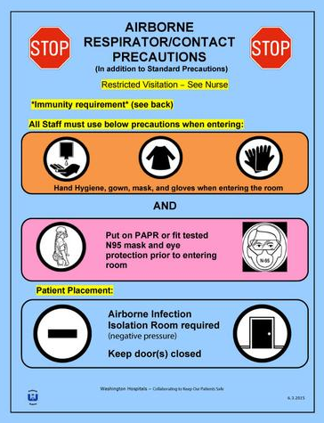
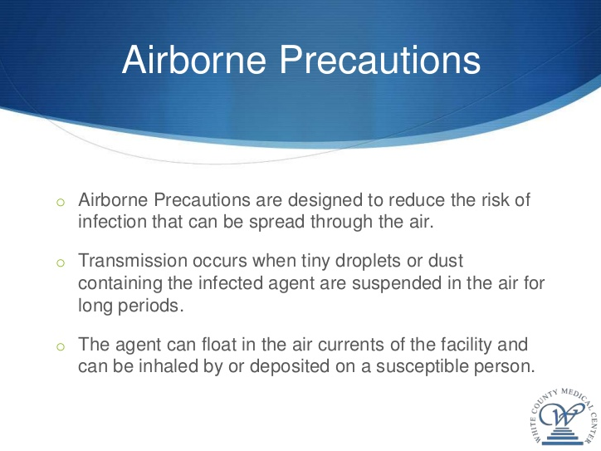
Airborne Precautions

Slide 30
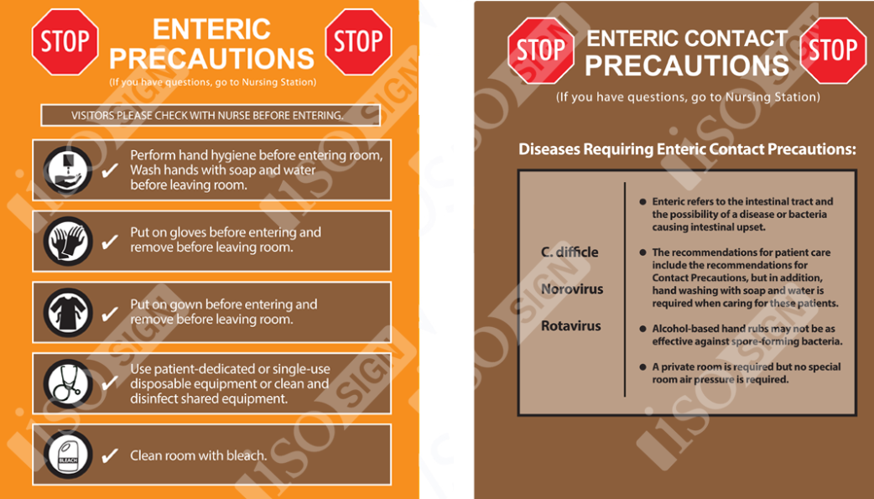
Enteric Precautions

Slide 31
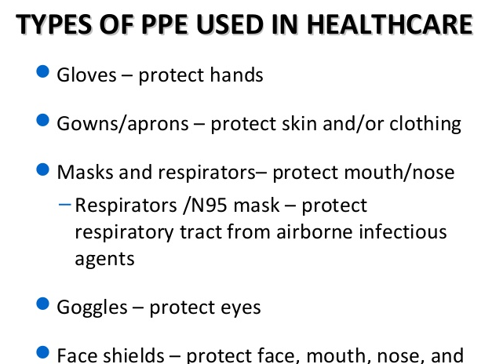
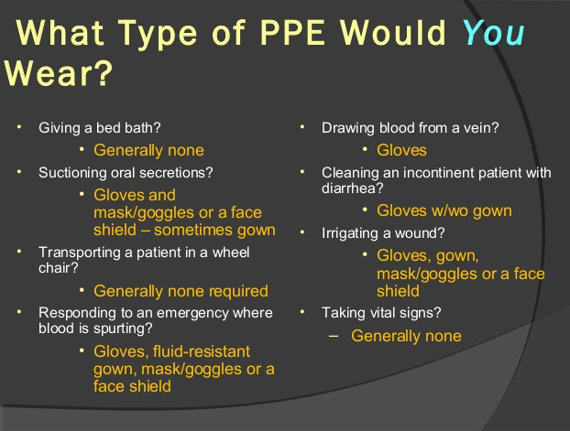
Personal Protective Equipment (PPE)
What….
And where

Slide 32
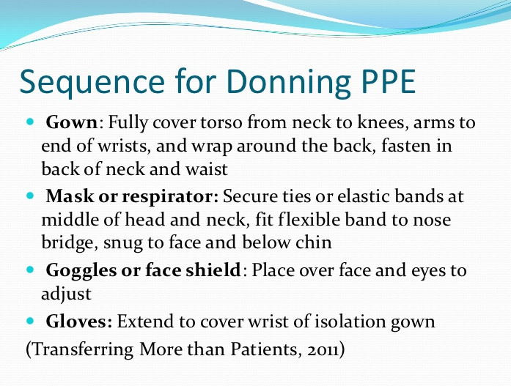
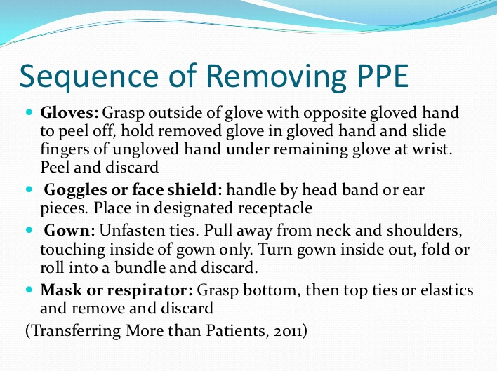
PPE…putting it on and taking it off

Slide 33
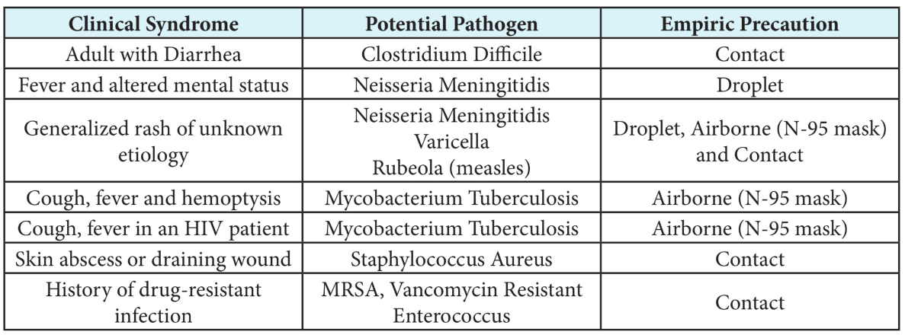
Some final thoughts on PPE
What does the patient have?
Finally….
Leave it in the room. Remove all PPE before leaving a room. The only exception being airborne isolation-take mask off after leaving room
PPE does not belong in the hallway, the cafeteria, the nursing station…
Gloves are PPE-take them off when leaving a room…unless you are carrying a dirty bedpan

Slide 34
Disinfection

Slide 35
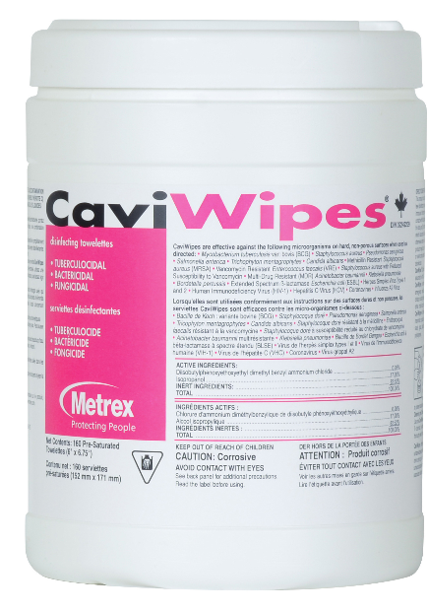
Cavi-Wipe Disinfectants
Non-porous surfaces and fixtures
“Stand time” is critical
Tuberculocidal
Bactericidal
Virucidial
Fungicidal
“Stand time” is 3 minutes
Will NOT kill C. difficile

Slide 36
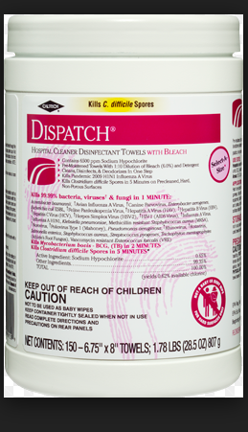
Dispatch
Non porous surfaces and fixtures
Chorine based
Recommended for use with patients with diarrhea and BBP contamination has occurred
Tuberculocidal
Bactericidal
Virucidal
Fungicidal
“Stand time” is 5 minutes to kill C. dificile spores

Slide 37
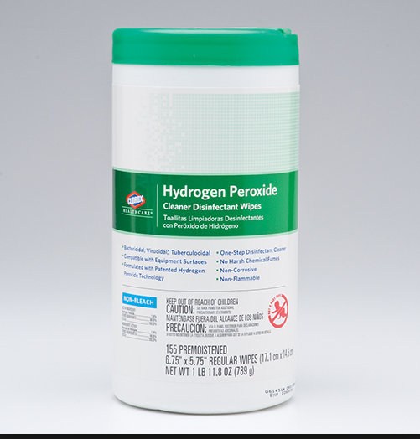
Hydrogen Peroxide
Non-porous and “soft” surfaces
Bacteriacidal
Tuberulocidal
Virucidal
Fungicidal
“Stand time” for tuberculosis is 5 minutes

Slide 38
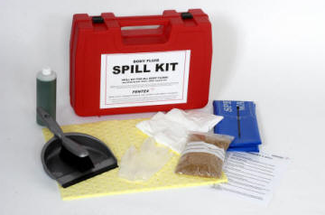
Spill Kits
Contain the spill
  Prevent tracking
    Prevent slips and falls

Slide 39
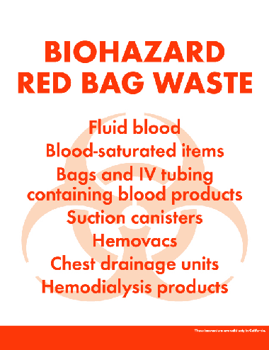
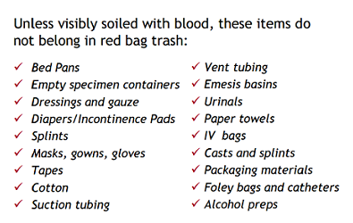
Medical Waste vs Biohazardous Waste
What goes were….and why it matters
Biohazardous Waste
Medical Waste

Slide 40


Red bags: The Bad and The Ugly

Slide 41

Yellow Bags: More Bad and Ugly

Slide 42
The 10 Safe Injection and Infusion Practices
1. Aseptic technique
2. Designated, disinfected prep area
3. CDC Rule: One needle, one syringe, one time
4. No use of vials “beyond use date”-28 days after being opened
5 If single dose vial is used for multiple patients, must be prepared by pharmacy under laminar flow-no preservative
6. Multi-dose vial for only one patient if possible
7. 70% alcohol to vial stopper and allow to dry
8. Infusion sets single patient only
9. Change IV tubing and IV site every 72 hours
10. Change IV bags every 24 hours

Slide 43
Policy and Procedure
Infection Control Policy and Procedure is currently being revised
Current P/P can be found under the Quality Management shortcut
As P/P changes, staff will be given education
P/P also depends on YOUR eyes-what is needed in your work area?
  Questions?
  Concerns?
  If you don’t ask, it can’t be addressed

Slide 44
Contact Information
Tricia Logan, RN
Interim Infection Control Nurse
Tohono O’odham Nation Health Care
Sells Hospital
Tel: (520) 383-7321
Fax: (520) 383 7261
Cell: (520) 274-0051
tricia.logan@tonation-nsn.gov

Slide 45
Questions?

